Slide 1
DeyGo
A Passenger Positioning System

Slide 2
What we’ll discuss
01
02
03
System Overview
Design System
App navigation
Key features, functionalities and additional features
Design approach, decisions and tools.
UI/UX implementation, wireframing

Slide 3
01
02
03
System Overview
Design System
App Navigation

Slide 4
System Overview
1
3
Key Features
Passenger Functionalities
2
4
Driver Functionalities
Additional Features

Slide 5
Summary of Overview
1
2
3
4
Priorities
Driver Role
Passenger Role
Future Features
Security and privacy of users.
Accept rides, view population density on map.
Book rides and share location.
Rate app, Message driver.

Slide 6
01
02
03
System Overview
Design System
App Navigation

Slide 7
Design System
Decisions
Colors
Approach
Tools

Slide 8
Design Decisions
Color palette
Lay out
SImple palette with 4 main colors and multiple styles for each
Mounted on iphone 13 promax because of suitable dimensions
02
04
01
03
05
Typography
Visual Hierarchy
Micro interactions
Carefully chosen font (urbananist) to ease readability
Putting important info on top of less important info
Call to actions, icons and illustrations

Slide 9
Colors
1
2
3
Primary
Secondary
Tertiary
A good shade of orange for backgrounds
A unique shade of black for texts
An outstanding grey for differentiating color stops

Slide 10
Design Approach
01
Modular Approach
Small modules like buttons, inputs (components) to ease mounting pages
02
User Centric Approach
Empathizing with user from start to end.

Slide 11
01
02
03
System Overview
Design System
App Navigation

Slide 12
App Navigation
Onboarding Screens
Passenger Screens
Welcoming user and presenting app.
Home, Bookings and Payments
Driver Screens
Hybrid screens
Home, Routes and Rides
Authentication and Account

Slide 13
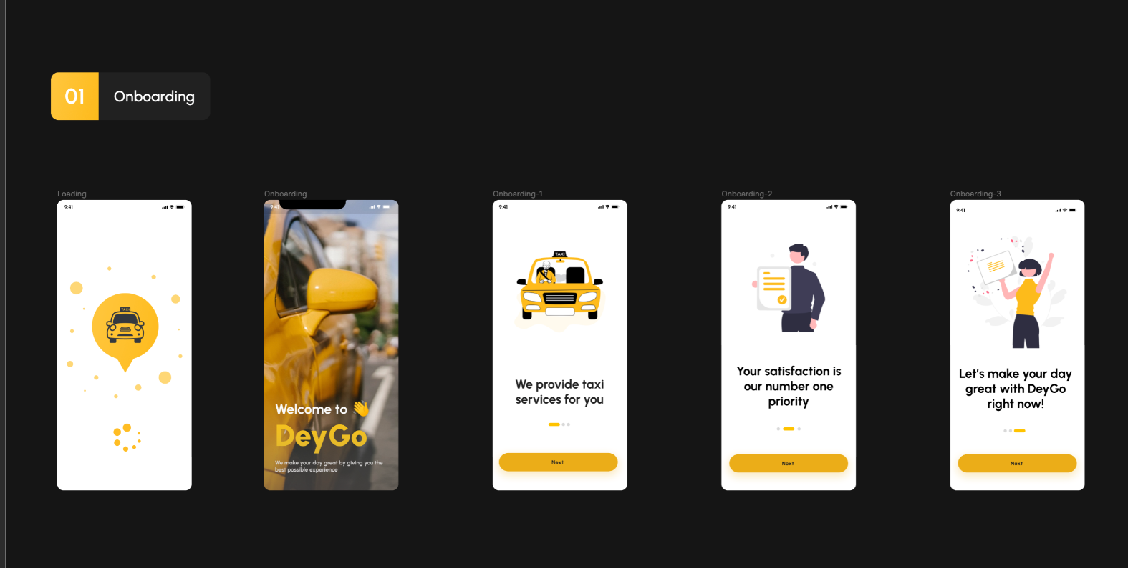
Onboarding

Slide 14
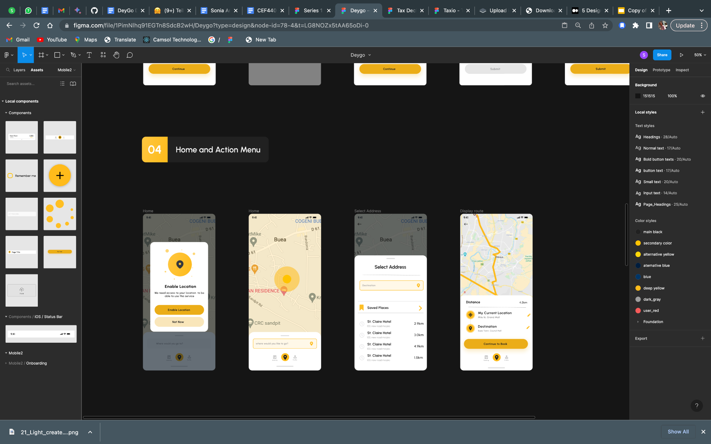
Passenger Screens
Enable Location
Enable location services on landing.
Home
Input tentative destination
Select Address
Select an accurate address
Display route
Add optimal route to map

Slide 15
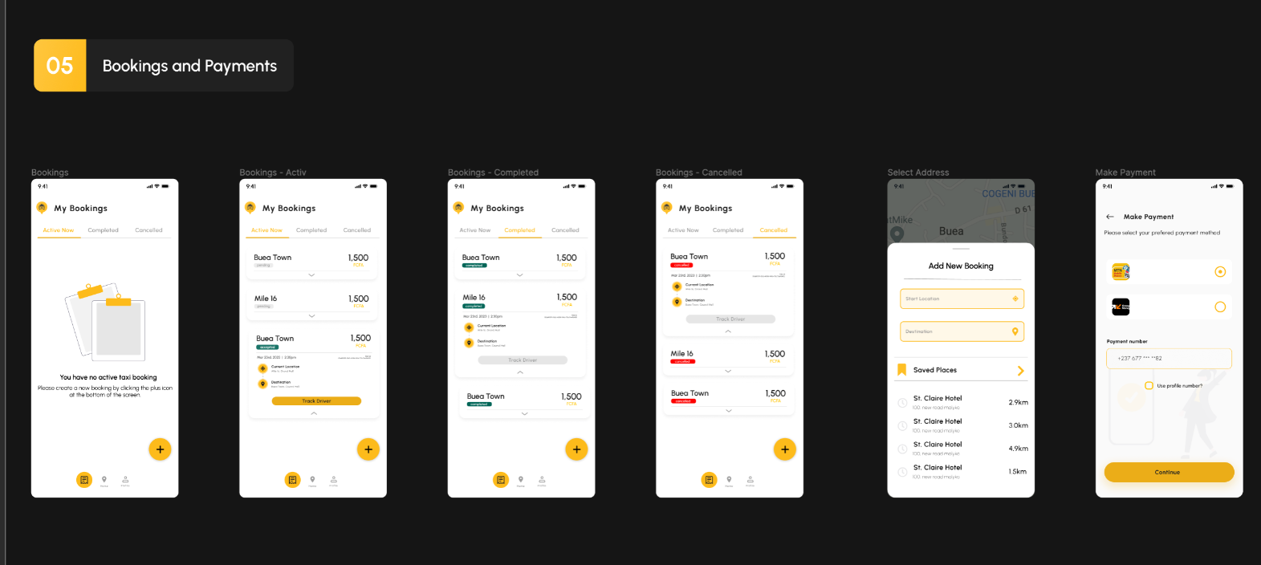
Passenger Screens
Bookings
View active, completed and canceled bookings
Bookings
Add new booking
Bookings
Track driver for accepted bookings
Payments
Make Payments for bookings

Slide 16
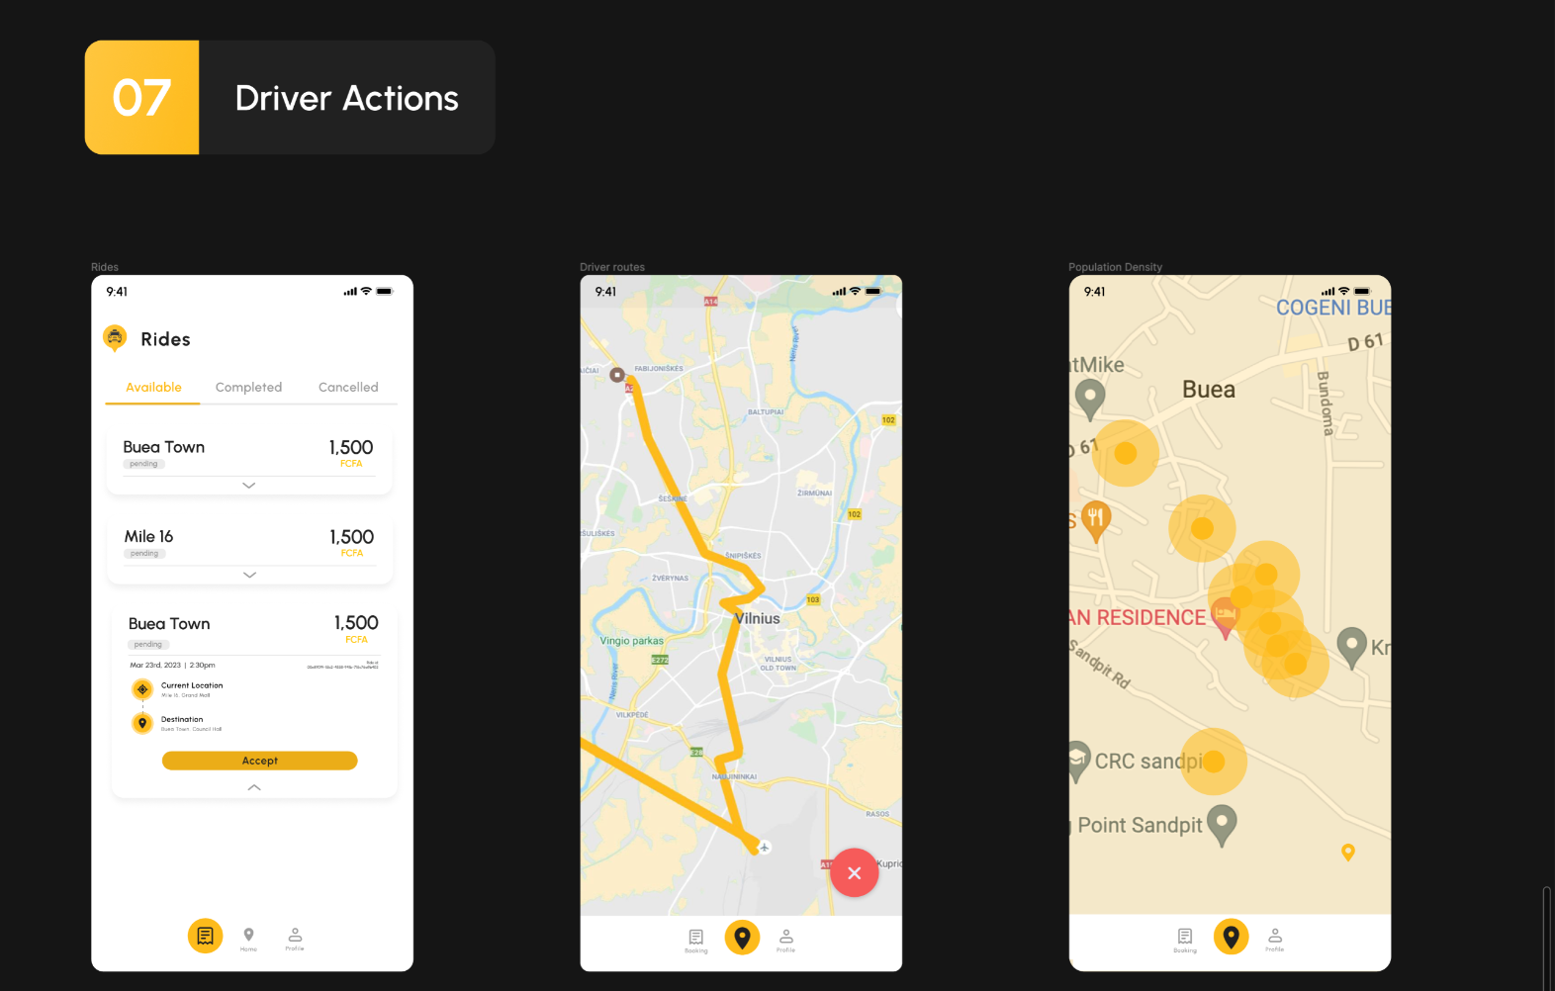
Driver Screens
Rides
Drivers can view available, completed and canceled rides
Driver routes
Driver can view optimized route
Population Density
The map displays population density of all areas

Slide 17
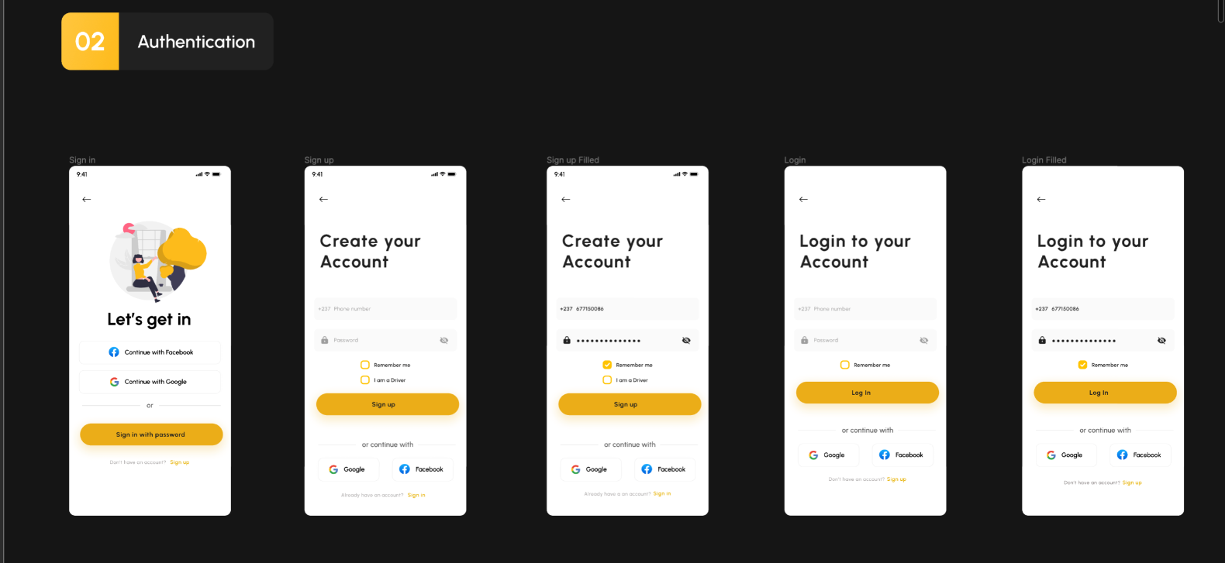
Hybrid Screens

Slide 18
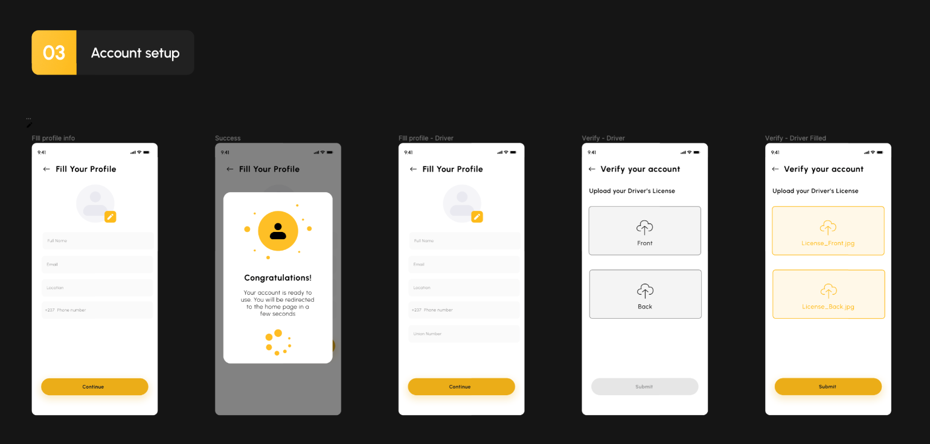
Hybrid Screens

Slide 19
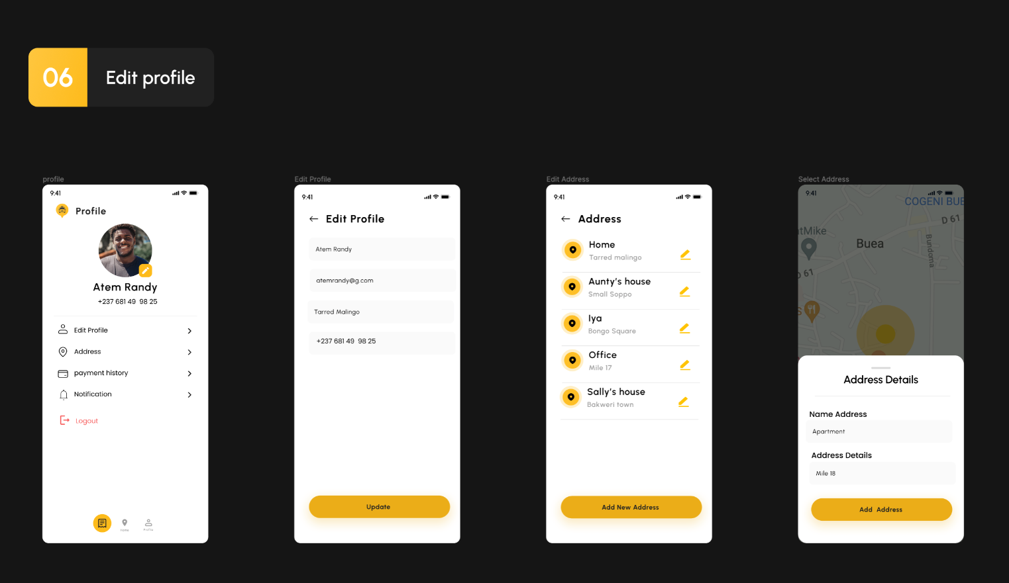
Hybrid Screens

Slide 20
Summary
Step 1
Step 2
Step 3
Book a ride
Get a ride
Enjoy your ride

Slide 21
?
Need a Taxi?
Just DeyGo
DeyGo

Slide 22
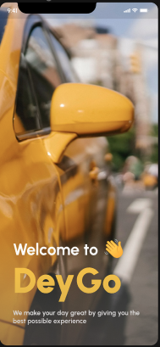
Taxi Infographics
01
02
03
Book
Connect
Destination

Slide 23
We have arrived our final Destination.
Thanks for listening!
A
B

